Slide 1

PRINCIPLES OF ECONOMICS 7TH EDITION
N. GREGORY MANKIW
Chapter Two: Thinking Like an Economist

Slide 2
Look for the answers to these questions:
What are economists’ two roles? How do they differ?
What are models? How do economists use them?
What are the elements of the Circular-Flow Diagram? What concepts does the diagram illustrate?
How is the Production Possibilities Frontier related to opportunity cost? What other concepts does it illustrate?
What is the difference between microeconomics and macroeconomics? Between positive and normative?

Slide 3

The Economist as a Scientist
Economists play two roles:
Scientists: try to explain the world
Policy advisors: try to improve it
As scientists, economists employ the scientific method
The scientific method: Observation, theory & more observation
Dispassionate development and testing of theories about how the world works

Slide 4
The Economist as a Scientist
The Role of Assumptions
Simplify the complex world and make it easier to understand
Example: to study international trade, assume two countries and two goods
Economic Models: Economists use models to study economic issues
Highly simplified representation of a more complicated reality

Slide 5
The Economist as a Scientist
Examples of models:
The model teeth at the dentist’s office
A model of human anatomy from high school biology class
A road map

Slide 6
The Economist as a Scientist
The Circular-flow diagram model
Visual model of the economy
Shows how dollars flow through markets among households and firms
Two decision makers
Firms and Households
Interacting in two markets
Market for goods and services
Market for factors of production (inputs)

Slide 7







Figure 1
The circular flow
Households:
Own the factors of production, sell/rent them to firms for income
Buy and consume goods & services
Households
Firms
Firms:
Buy/hire factors of production, use them to produce goods and services
Sell goods & services

Slide 8



Figure 1
The circular flow
Revenue
Spending
Markets for Goods & Services
G & S sold
G & S bought
Firms
Households
Factors of production
Labor, land,
Markets for Factors of Production
capital
Wages, rent, profit
Income

Slide 9
The PPF Model
Production possibilities frontier
A graph: combinations of output that the economy can possibly produce
Given the available
Factors of production and technology
Example:
Two goods: computers and wheat
One resource: labor (measured in hours)
Economy has 50,000 labor hours per month available for production

Slide 10

PPF Example
Producing one computer requires 100 hours labor. Producing one ton of wheat requires 10 hours labor.
 | Employment of labor hours |  | Production
 | Computers | Wheat | Computers | Wheat
A | 50,000 | 0 | 500 | 0
B | 40,000 | 10,000 | 400 | 1,000
C | 25,000 | 25,000 | 250 | 2,500
D | 10,000 | 40,000 | 100 | 4,000
E | 0 | 50,000 | 0 | 5,000

Slide 11
PPF Example
Point on graph | Production
 | Com- puters | Wheat
A | 500 | 0
B | 400 | 1,000
C | 250 | 2,500
D | 100 | 4,000
E | 0 | 5,000
Wheat (tons)
6,000
5,000
4,000
3,000
2,000
1,000
0
E
D
C
B
A
0 100 200 300 400 500 600
Computers

Slide 12
Active Learning 1 Points off the PPF
On the graph above, find the point that represents (100 computers, 3000 tons of wheat), label it F.
Would it be possible for the economy to produce this combination of the two goods? Why or why not?
Next, find the point that represents (300 computers, 3500 tons of wheat), label it G.
Would it be possible for the economy to produce this combination of the two goods?

Slide 13
Active Learning 1
Answers
Point F: 100 computers, 3000 tons wheat
Requires 40,000 hours of labor
Possible but not efficient: could get more
of either good without sacrificing any of the other
Wheat (tons)
6,000
5,000
4,000
3,000
2,000
1,000
0
F
0 100 200 300 400 500 600
Computers

Slide 14
Active Learning 1
Answers
Point G: 300 computers, 3500 tons wheat
Requires 65,000 hours of labor.
Not possible because the economy only has 50,000 hours
Wheat (tons)
6,000
5,000
4,000
3,000
2,000
1,000
0
G
0 100 200 300 400 500 600
Computers

Slide 15
The PPF: What We Know So Far
Points on the PPF (like A – E): possible
Efficient: all resources are fully utilized
Points under the PPF (like F): possible
Not efficient: some resources are underutilized (e.g., workers unemployed, factories idle)
Points above the PPF (like G)
Not possible

Slide 16
The PPF
Moving along a PPF
Involves shifting resources from the production of one good to the other
Society faces a tradeoff
Getting more of one good requires sacrificing some of the other
The slope of the PPF
The opportunity cost of one good in terms of the other

Slide 17
The PPF and Opportunity Cost
Wheat (tons)
6,000
5,000
4,000
3,000
2,000
1,000
0
The slope of a line equals the “rise over the run.”
slope = ^{–1000} = –10
100
Opportunity cost of 1 computer =
10 tons of wheat.
0 100 200 300 400 500 600
Computers

Slide 18


Economic Growth and the PPF
With additional resources or an improvement in technology,
the economy can produce more computers,
Wheat (tons)
6,000
5,000
4,000
3,000
2,000
1,000
0
Economic growth shifts the PPF outward.
more wheat,
0 100 200 300 400 500 600
Computers
or any combination in between.

Slide 19
The Shape of the PPF
Shape of the PPF
Straight line: constant opportunity cost
Previous example: the opportunity cost of 1 computer is 10 tons of wheat
Bowed outward: increasing opportunity cost
As more units of a good are produced, we need to give up increasing amounts of the other good produced

Slide 20
Why the PPF Might Be Bowed Outward
Computer
As the economy shifts resources from computer to automated cars:
PPF becomes steeper
and the opportunity cost of automated cars increases.
Automated
Cars

Slide 21


Why the PPF Might Be Bowed Outward
At A, opportunity cost of automated cars is low.
At point A, most workers are producing computers, even those who are better suited to building automated cars.
Computer
A
So, do not have to give up much computers to get
Automated
Cars
more cars.

Slide 22


Why the PPF Might Be Bowed Outward
At B, most workers are producing cars. The few left in computers production are the best.
Producing more cars would require shifting some of the best producers away from computer production
causing a big drop in
Computers
A
B
At B, opportunity cost of automated car is high.
Automated
Cars
computer output.

Slide 23
Why the PPF Might Be Bowed Outward
The PPF is bowed outward when:
Different workers have different skills
Different opportunity costs of producing one good in terms of the other
There is some other resource, or mix of resources with varying opportunity costs
E.g., different types of land suited for different uses

Slide 24
The Economist as a Scientist
Microeconomics
The study of how households and firms make decisions and how they interact in markets
Macroeconomics
The study of economy-wide phenomena, including inflation, unemployment, and economic growth

Slide 25
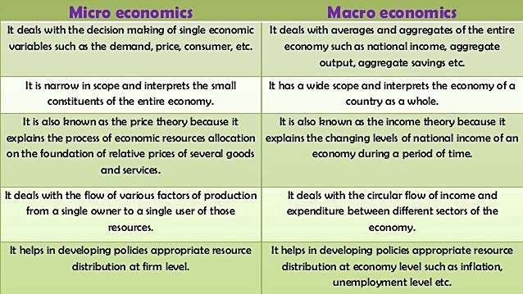

Slide 26
The Economist as Policy Adviser
Positive statements: descriptive
Attempt to describe the world as it is
Confirm or refute by examining evidence: “Minimum-wage laws cause unemployment”
Normative statements: prescriptive
Attempt to prescribe how the world should be: “The government should raise the minimum wage”

Slide 27
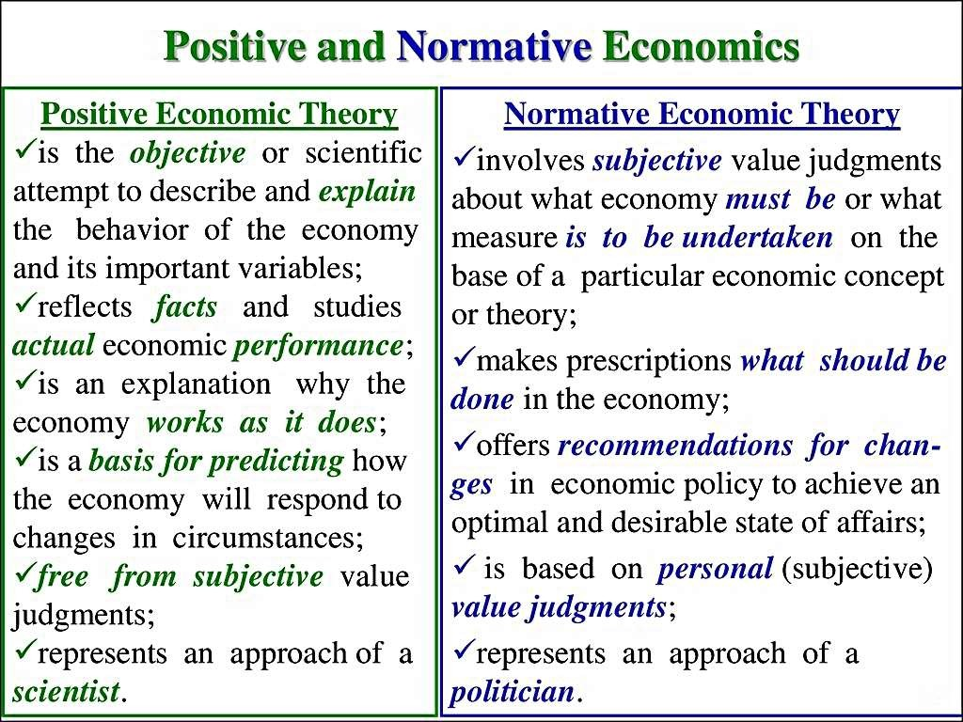

Slide 28
Active Learning 3 Positive vs. Normative
Which of these statements are “positive” and which are “normative”? How can you tell the difference?
Prices rise when the government increases the quantity of money.
The government should print less money.
A tax cut is needed to stimulate the economy.
An increase in the price of burritos will cause an increase in consumer demand for music downloads.

Slide 29
Active Learning 3 Answers
Prices rise when the government increases the quantity of money.
Positive – describes a relationship, could use data to confirm or refute.
The government should print less money. Normative – this is a value judgment, cannot be confirmed or refuted.

Slide 30
Active Learning 3
Answers
c. A tax cut is needed to stimulate the economy.
Normative – another value judgment.
d. An increase in the price of burritos will cause an increase in consumer demand for music downloads
Positive – describes a relationship.
Note that a statement need not be true to be positive.

Slide 31
Summary
Economists are scientists
Make appropriate assumptions and build simplified models
The circular-flow diagram and the production possibilities frontier
Micro economists study decision making by households and firms and their interactions in the marketplace
Macroeconomists study the forces and trends that affect the economy as a whole

Slide 32
Summary
A positive statement is an assertion about how the world is
A normative statement is an assertion about how the world ought to be
As policy advisers, economists make normative statements
Economists sometimes offer conflicting advice
Differences in scientific judgments
Differences in values

